Slide 1
Financial Information System
Change Network- Kick off Meeting

Slide 2
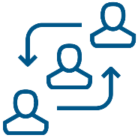
Change Network Topics
Change Network Overview
Sponsorship Resources and Updates
Next Steps and Action Items

Slide 3
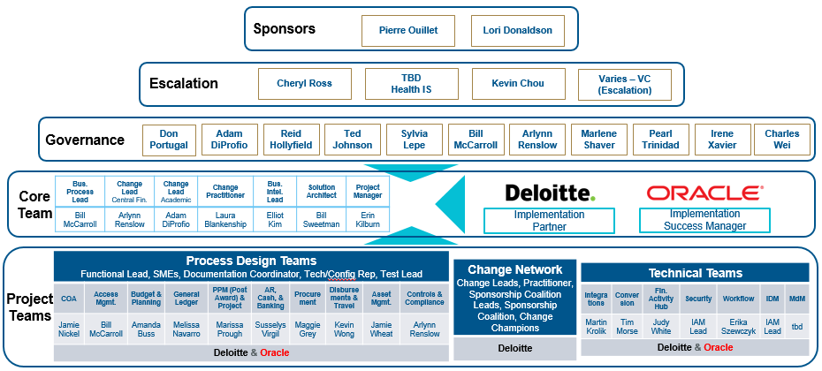
Project Structure

Slide 4
Change Structure
Our goal is to organize leaders, at all levels of the University, to coordinate communication, so end users hear the right messages from the right people. Change Network members are local sponsors and serve as an extension of the project Change Leads. Learn more about Change Network roles and responsibilities.
Executive Team
Change Network
Primary Sponsors
and FIS Governance
Sponsor Coalition Lead
Sponsorship
Coalition
Change
Champions
Launches change
and actively sponsors among the financial community
Serves as org. sponsor, and primary contact for the Change Lead and Sponsorship Coalition
Serves as the leader, executor, and communicator for their Division and/or Department.
Disseminates and advocates for positive change among impacted units and teams
Active and visible participation; communicates key messages from the Core Team
Support communications from Change Leads
Track readiness and provide two-way communication
Share communications and set priority

Slide 5
Change Network
Ex. Academic Affairs Change Network
Visit the FIS Change Network webpages to view a comprehensive list of representatives.
Notes:
Sponsors, as a general term, refers to anyone who is supportive of the change. Sponsors promote the change with their actions, behaviors and conversations. According to Prosci, Middle managers and supervisors are sometimes the most powerful sponsors of change.
Change Network serves as an extension of the primary sponsor, governance, and project team
Objectives:
1. Ensure all areas have coverage where at least one contact will pass along information via meetings, road shows and other inter-personal activities.
2. Allow for department users to have one local representative where they can pass along their thoughts and concerns, and receive information.

Slide 6
Sponsorship Activities
5%
Estimated effort required by Sponsorship Coalition
Primary Sponsors
Help address and manage resistance, especially to the Guiding Principles, and step in for critical decisions
Stay current with key milestones achieved and project schedule/scope updates
Attend/participate in the Town Hall event and Training Expos
Publicly recognize individuals and teams
Maintain monthly contact with Change Lead and Sponsorship Coalition Members
Communicate core team updates through local Change Network channels
Stay current on key milestones achieved and project schedule/scope updates
Attend People Manager workshop
Sponsorship Coalition Lead
Attend monthly Change Network meeting
Maintain regular contact with Sponsorship Coalition Lead regarding FIS project
Encourage staff to read FIS newsletters, attend trainings, and visit FIS web pages
Embrace CLARC + ADKAR
Coach and manage resistance within teams
SMEs for end-user testing and training
Sponsorship Coalition & Change Champions
Notes:
Expectations: Effort should be less than 5% for now. We are estimating one meeting per month with Change Leads, one meeting per month to share with their group, and then a few more hours to deal with individual ad-hoc discussions, resistance management, etc.
Sponsorship Guidance from Prosci Best Practices
#1 – The number one obstacle to success for major change initiatives is ineffective sponsorship
#2 – Project teams ranked 50% of their sponsors as having only a moderate to low understanding of their role managing the people side of change and graded them a “average to poor” in terms of sponsorship activities
Mistakes or “ineffective sponsorship”:
1. Failed to remain active and visible throughout the life of the project
2. Underestimated or misunderstood the people side of change
3. Failed to communicate messages about the need for change
4. Delegated the sponsorship role and responsibilities

Slide 7
Sponsorship Resources
As part of the Change Network your role is to serve as your unit’s “CLARC.”
To support you in your role, the project team will provide you with training, tips and tricks, and the following tools throughout the change:
An email Distribution List with all Change Network members in your area to facilitate communication, provide feedback loops, and manage unit readiness: fiscn-cfo-l@ucsd.edu
Communicator
Liaison
Email communications and readiness activities to set FIS as your unit’s priority and ensure preparedness
Advocate
Resistance Manager
Presentations and talking points to spark discussion at your department meetings
Coach
Financial Information System webpages to keep your unit in sync with updates, communications, and change network resources.

Slide 8
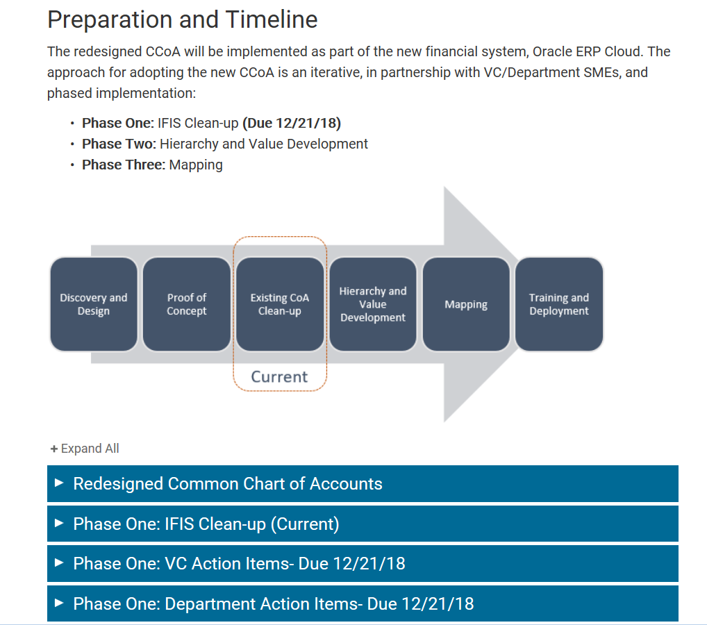
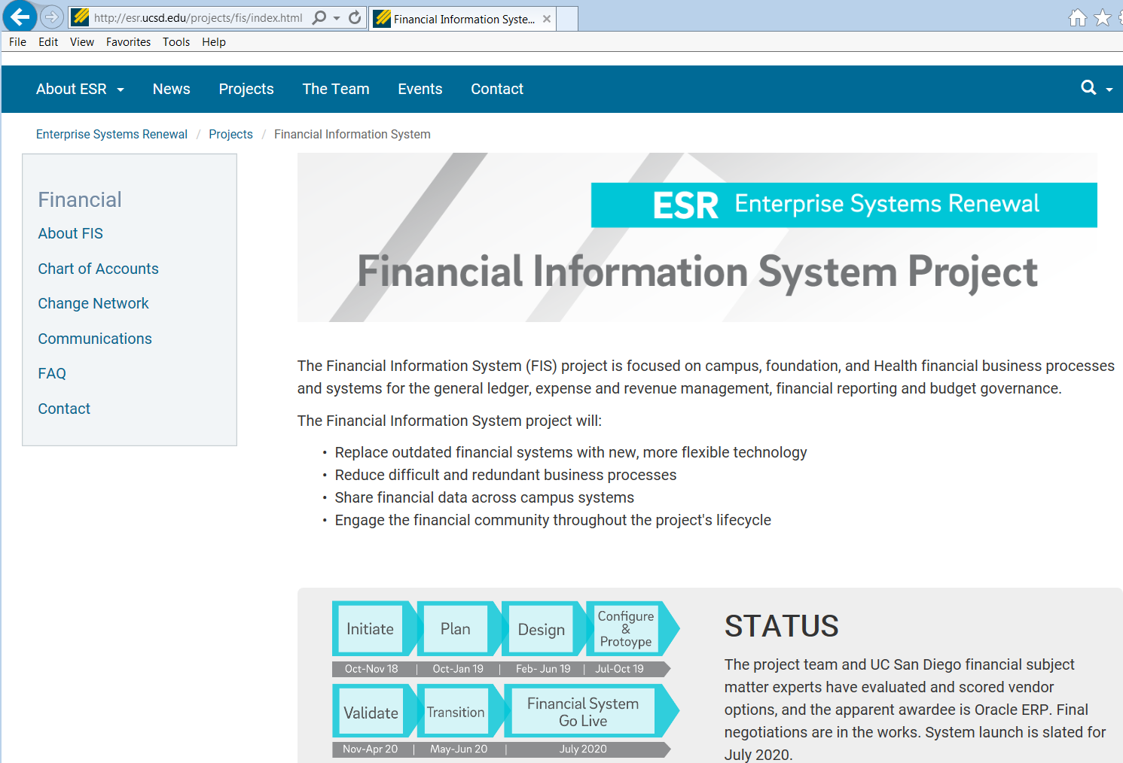
Sponsorship Resources
Visit our redesigned Financial Information Systems web pages for updates, project communications, and change network representatives: esr.ucsd.edu/fis

Slide 9
Phases
We Are Here
1. Identification and Initiation
2. Concept and Business Case
3. Requirements and Analysis
4. Preliminary Design
5. Detailed Design
6. Implementation and Configuration
7. Validation and Test
8. Transition
9. Operations and Maintenance
10. Decommission
Notes:
Erin (~1 minute)

Slide 10
Next Steps- Learning Events
FIS Town Hall
January 31st @ 9-10:30 am in Great Hall. RSVP only for in-person, live-streaming available for campus community. CFO visions, Oracle design approach and teams, project updates with three month schedule and much more!
January 31st @ 1:30 pm in Triton 1 & 2 (TPCS 3rd floor). Financial activity hub content:
Financial Activity Hub
What financial reporting is available now?
What training is available now?
What’s going to change?
What financial data will be available in the future?
What support will be available in the future?
People Manager Workshop
February 25, 2019 in Price Center. People Managers (i.e., designated supervisors in key leadership and management positions) impacted by currently running ESR projects first. Training will provide an overview of ESR, your role in change management as a People Manager, its importance to successful change initiatives, and strategies, tools and contacts to manage your team through the changes.
CCoA Q&A Panel Session
April via zoom. Join us for a campus-wide Q&A session with panel CoA experts, and get answers to your questions regarding changes in the chart of accounts.

Slide 11
Next Steps- Action Items
Chart of Accounts (CoA)
Continue department CoA clean-up activities (target December 21, 2018, but efforts are ongoing)
Finalize new CoA design and define initial CoA segment values
New CoA design will be integrated into Configuration Design and CRP1
Functional Teams
Recommend SMEs to serve as end users for process design teams
Familiarization and Oracle training scheduled for design leads by end of January
Finalizing design teams and backfill requests
Change Management
Introduce yourself and your role on the FIS Change Network Direct staff to project resources, including newsletters and the website at staff meetings (esr.ucsd.edu/fis)
Share FIS information at department meetings and encourage your staff to share their viewpoints
Support attendance at ESR-FIS events
= Change Network support

Slide 12
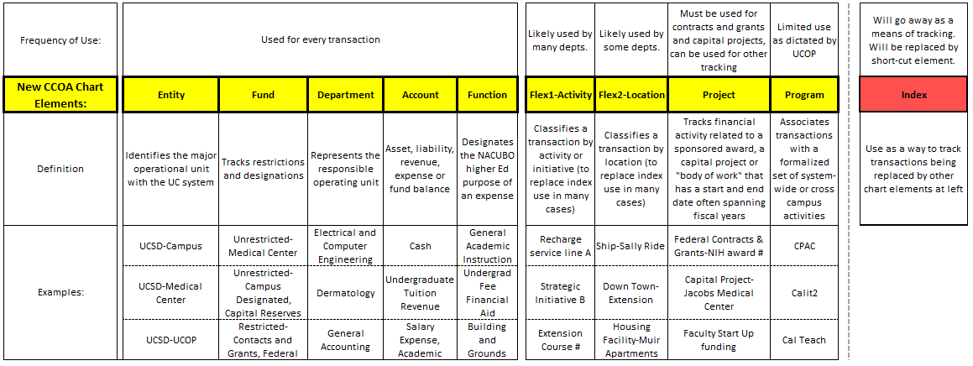
New Common Chart of Accounts Structure

Slide 13
Current IFIS Chart of Accounts Clean Up
Every active chart element in IFIS, including indexes, will need to be evaluated to determine whether the ‘tracking or reporting need' the element is serving will be needed in the new chart and new financial system, and how that element maps to the new chart of accounts.
Our goal is to review and evaluate IFIS chart elements and inactivate chart elements with a zero balance which are no longer needed so that the code does not need to be considered when mapping to the new system.
Clean-up and inactivations have been ongoing. Comparing last June 2018 to this December 2018 we have: 1,767 reduction (11%) in # of active funds—should be more to come 2,535 reduction (39%) in # of active orgs 2,055 reduction (36%) in # of active accounts 4,717 reduction (87%) in # of active program codes 25,932 reduction (28%) in # of active indexes
See the following COA clean-up section of the FIS webpage to review reports to assist you in your clean-up:

Slide 14
New Chart of Accounts Development General Accounting (GA) staff are working with UCOP to finalize the new chart element hierarchies, including classification and numbering. Numbering will all change to be consistent with the UC Common Chart of Accounts.
CURRENT
UPCOMING
The following new chart element hierarchies and values are in final draft form:
Entity
Asset accounts
Liability accounts
Function—previous IFIS Program
Program—new system-wide code
The Central Budget Office (Reshma Bir) is working on a final draft of the new Oracle Department (aka Organization) hierarchy and values.
The following new chart element hierarchies and values are in progress in GA with expected completion date by March 31, 2019:
Revenue accounts
Fund
Expense accounts
The following new chart element hierarchies and values will be determined and developed once Oracle functionality is reviewed and understood:
Activity
Location
Project

Slide 15
New Chart of Accounts and Transition to Oracle- Things to Think About…
Balance Sheet account mapping from IFIS to Oracle at 6/30/2020:
All balance sheet balances at 6/30/2020 will need to posted to Oracle as 7/1/2020 opening balances by account, fund, and DEPARTMENT. Currently in IFIS, balance sheet balances only exist by fund. 6/30/2020 balances will need to be assigned and posted to Department Codes which will indicate the department that is responsible for the account (disbursements and accounts payable) or the department that owns the account (Physician Group receivables). Start thinking about which department (current org) should be assigned to your balance sheet account balances
2) Remaining Budget Balance at 6/30/2020 posting to Oracle as carryforward:
Currently in IFIS, carryforward budget balances post all the way down to the detailed index level by account. It is likely that IFIS carryforward balances as of 7/1/2020 will need to be posted into Oracle at a higher summarized level by fund-department-account-function in order to ensure completeness and accuracy. The departments would then need to allocate that remaining budget, if they desire, to new activity and location codes or to projects and tasks in the Oracle project module.

